Slide 1



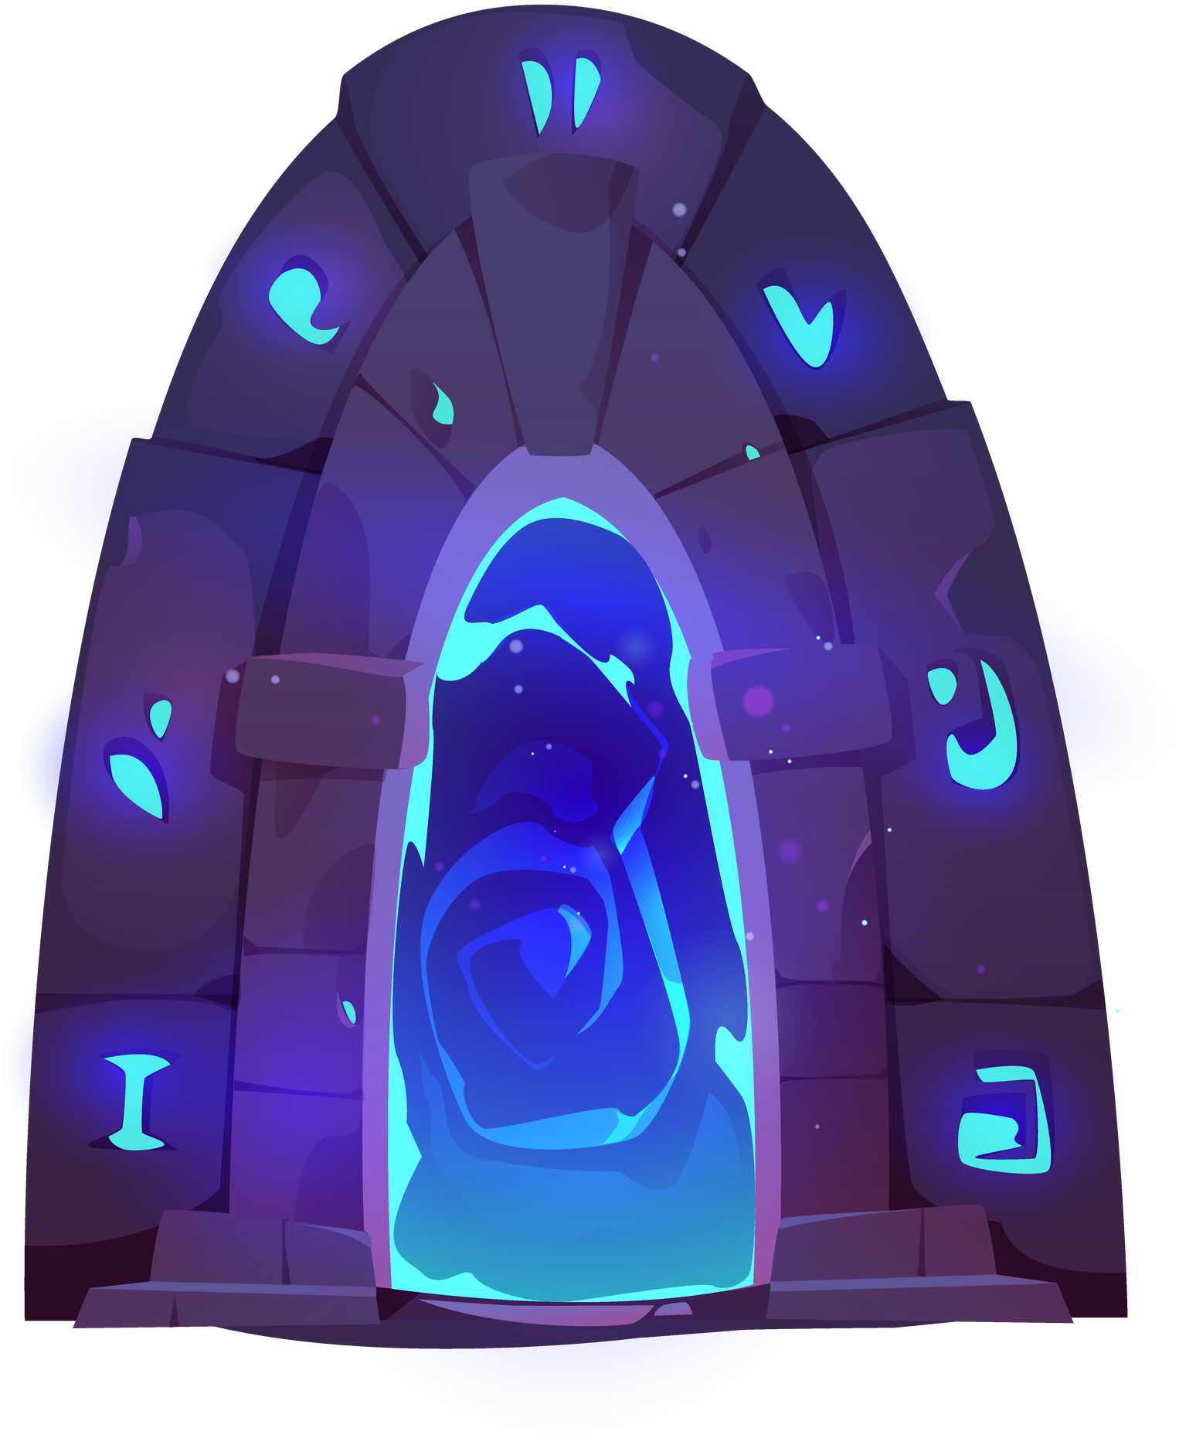
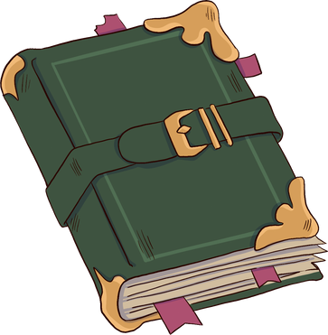
B2 English
1. Fantasy Writing

Slide 2
Learning Goals
Understand portals in fantasy writing
Identify how a fantasy portal is created
Apply our knowledge and build our own word banks.

Slide 3

Activate
Complete the mind map below exploring what you already know about fantasy writing. (e.g. what makes a good fantasy story, what type of language/words does it use?)
Fantasy Writing

Slide 4

Activate
Travelling through a portal
Imaginary worlds (e.g. Hogwarts)
Fantasy Writing
Mythical characters and setting
Something unnatural

Slide 5
Learn
What is a portal?
An entrance to a magical or another world

Slide 6
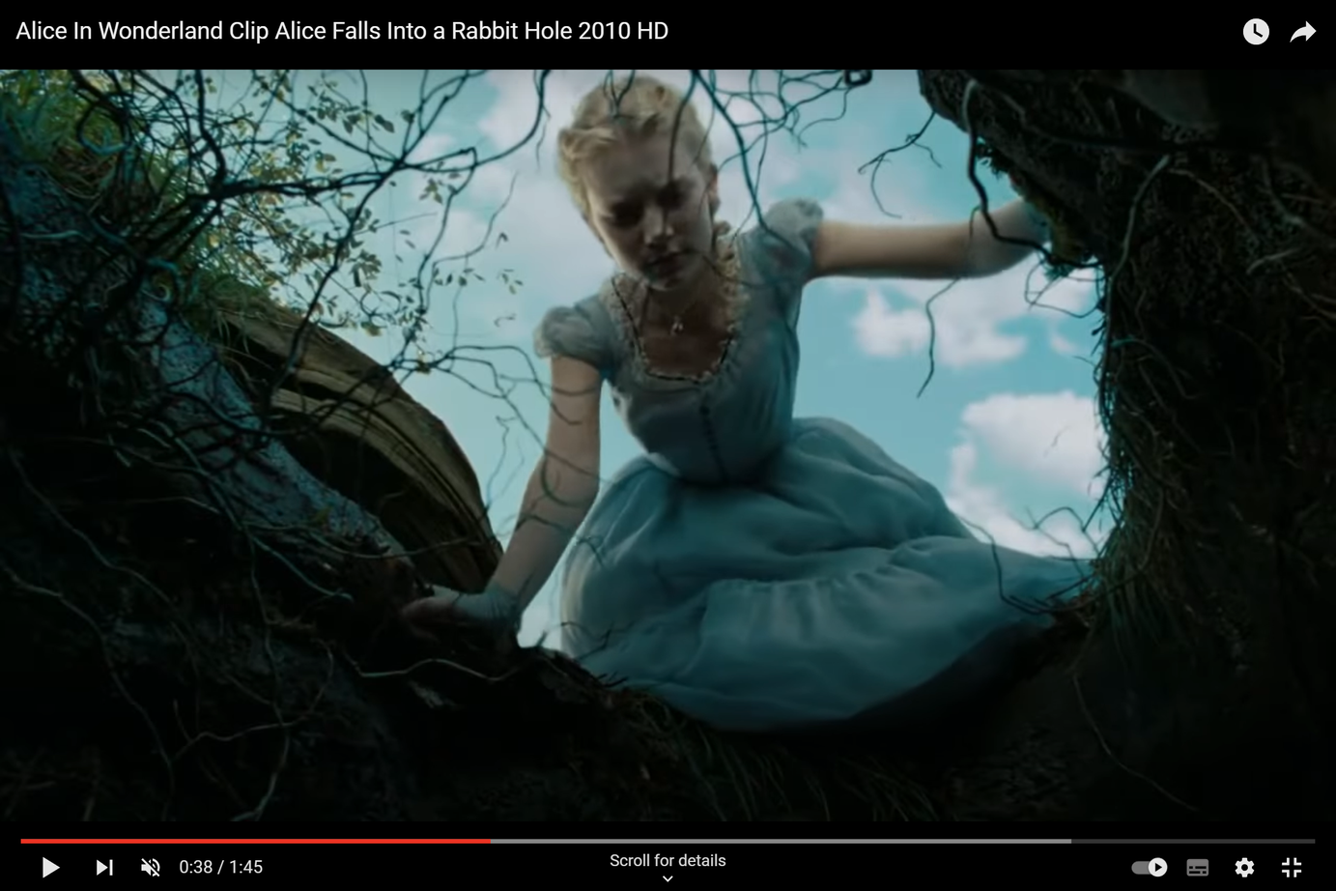
Learn
Watch Alice in Wonderland
Falling down the rabbit hole

Slide 7
Reading
Let’s read together. Underline or highlight any words you don’t understand.
Identify for the sentence where the story moves from reality to fantasy.
Alice was beginning to get very tired of sitting by her sister by the river, and having nothing to do: once or twice she had looked into the book her sister was reading, but it had no pictures or conversations in it, ‘and what is the purpose of a book,’ thought Alice ‘without pictures or conversations?’
So she was considering in her own mind (as best she could, because the hot day made her feel very sleepy and stupid), whether the pleasure of making a chain made from flowers would be worth the trouble of standing up and picking the flowers, when suddenly a White Rabbit with pink eyes ran close by her.
There was nothing special in that; and neither did Alice think it was very strange to hear the Rabbit say to itself, ‘Oh dear! Oh dear! I shall be late!’ (when she thought about it after, she realised she should have wondered at this, but at the time it all seemed natural); but when the Rabbit actually took a watch out of its jacket-pocket, and looked at it, and then hurried on, Alice stood up, for she realised she had never before seen a rabbit with either a waistcoat-pocket, or a watch to take out of it, and burning with curiosity, she ran across the field after it, and fortunately was just in time to see it pop down a large rabbit-hole under the hedge.

Slide 8
Reading
Did you identify the sentence where the story moves from reality to fantasy?
Alice was beginning to get very tired of sitting by her sister by the river, and having nothing to do: once or twice she had looked into the book her sister was reading, but it had no pictures or conversations in it, ‘and what is the purpose of a book,’ thought Alice ‘without pictures or conversations?’
So she was considering in her own mind (as best she could, because the hot day made her feel very sleepy and stupid), whether the pleasure of making a chain made from flowers would be worth the trouble of standing up and picking the flowers, when suddenly a White Rabbit with pink eyes ran close by her.
There was nothing special in that; and neither did Alice think it was very strange to hear the Rabbit say to itself, ‘Oh dear! Oh dear! I shall be late!’ (when she thought about it after, she realised she should have wondered at this, but at the time it all seemed natural); but when the Rabbit actually took a watch out of its jacket-pocket, and looked at it, and then hurried on, Alice stood up, for she realised she had never before seen a rabbit with either a waistcoat-pocket, or a watch to take out of it, and burning with curiosity, she ran across the field after it, and fortunately was just in time to see it pop down a large rabbit-hole under the hedge.

Slide 9
Reading
Let’s read together. Underline or highlight any words you don’t understand.
Alice went after it, never once considering how she would get out again. The rabbit-hole went straight like a tunnel for a long way, and then dipped suddenly down, so suddenly that Alice didn’t have a second to think about stopping herself before she found herself falling down a very deep well. Either the well was very deep, or she fell very slowly, because she had plenty of time as she went down to look around her and wonder what was going to happen next.
First, she tried to look down and see what was coming towards her, but it was too dark to see anything; then she looked at the sides of the well, and noticed that they were filled with cupboards and book-shelves; she saw maps and pictures hung up. She took down a jar from one of the shelves; it was labelled ‘ORANGE MARMALADE’, but to her great disappointment it was empty: she did not like to drop the jar for fear of killing somebody, so managed to put it into one of the cupboards as she fell past.

Slide 10
Comprehension
Let’s read together. Underline or highlight any words you don’t understand.
Alice went after it, never once considering how she would get out again. The rabbit-hole went straight like a tunnel for a long way, and then dipped suddenly down, so suddenly that Alice didn’t have a second to think about stopping herself before she found herself falling down a very deep well. Either the well was very deep, or she fell very slowly, because she had plenty of time as she went down to look around her and wonder what was going to happen next.
First, she tried to look down and see what was coming towards her, but it was too dark to see anything; then she looked at the sides of the well, and noticed that they were filled with cupboards and book-shelves; she saw maps and pictures hung up. She took down a jar from one of the shelves; it was labelled ‘ORANGE MARMALADE’, but to her great disappointment it was empty: she did not like to drop the jar for fear of killing somebody, so managed to put it into one of the cupboards as she fell past.
1. What does Alice enter that is the portal to this world?
2. Name three things that Alice sees as she travels downwards.
3. Did you like this story? Why? Why not?

Slide 11
Activate
Now using Alice and Wonderland, can you add any other features of fantasy writing?
Travelling through a portal
Imaginary worlds (e.g. Hogwarts)
Fantasy Writing
Mythical characters and setting
Something unnatural

Slide 12
Activate
Now using Alice and Wonderland, can you add any other features of fantasy writing?
Travelling through a portal
Imaginary worlds (e.g. Hogwarts)
Animals talking / acting human
Fantasy Writing
Something unnatural
Mythical characters and setting
A normal, realistic beginning

Slide 13
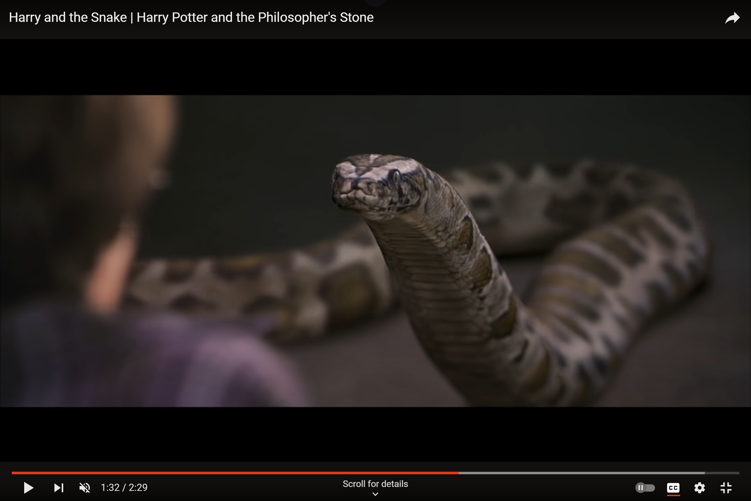
Activate
Here is another example of how a fantasy story goes from normal to magical...

Slide 14
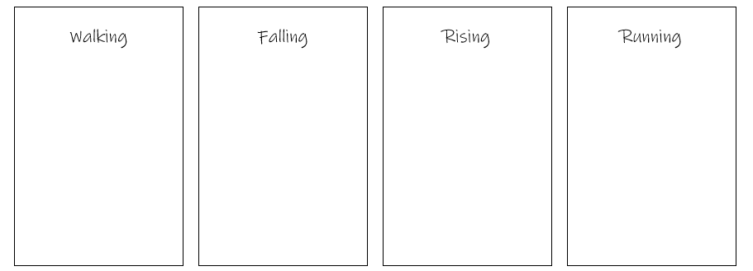
Activity
Building verbs to describe how your character will go through your portal.
Draw this table into your book.
Sort the verbs below into the synonym they match with.
Scurrying
Elevating
Marching
Jumping
Strolling
Sprinting
Floating
Zooming
Dashing
Tumbling
Lifting
Dropping

Slide 15
Feedback
Strolling
Dropping
Elevating
Scurrying
Marching
Tumbling
Lifting
Dashing
Jumping
Sprinting
Floating
Zooming

Slide 16
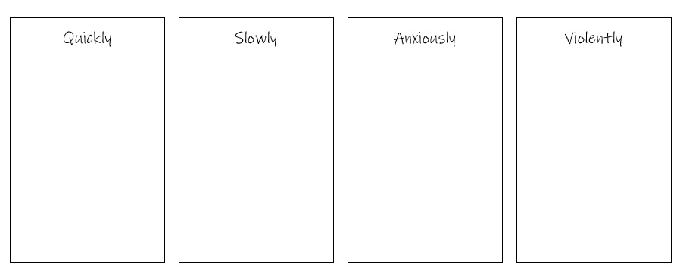
Activity
Building verbs to describe how your character will go through your portal.
Draw this table into your book.
Sort the adverbs below into the synonym they match with.
Leisurely
Fiercely
Aggressively
Rapidly
Forcefully
Briskly
Worriedly
Fearfully
Swiftly
Uneasily
Steadily
Gradually

Slide 17
Activity
Rapidly
Leisurely
Fearfully
Forcefully
Briskly
Gradually
Uneasily
Fiercely
Swiftly
Steadily
Worriedly
Aggressively

Slide 18
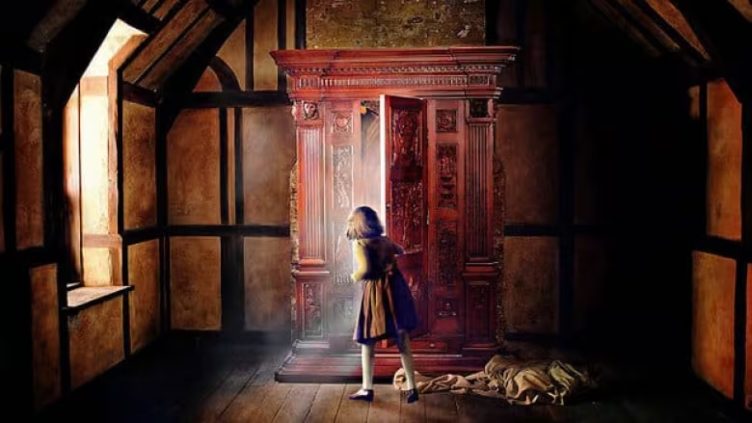
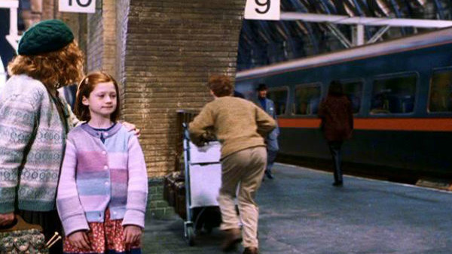
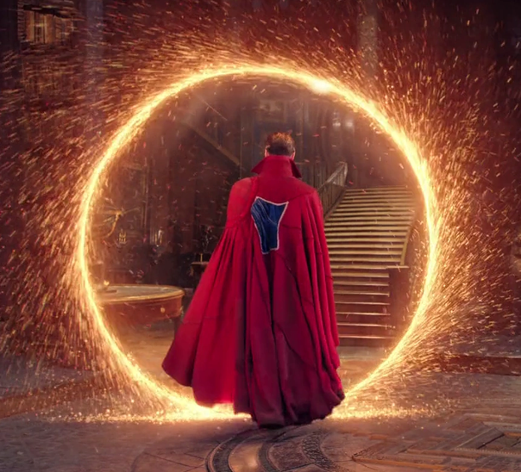
Activity
Portals to another world...
Look at these images of famous portals and discuss with your partner:
What the portal is
What book/film is it
Where it takes the characters

Slide 19
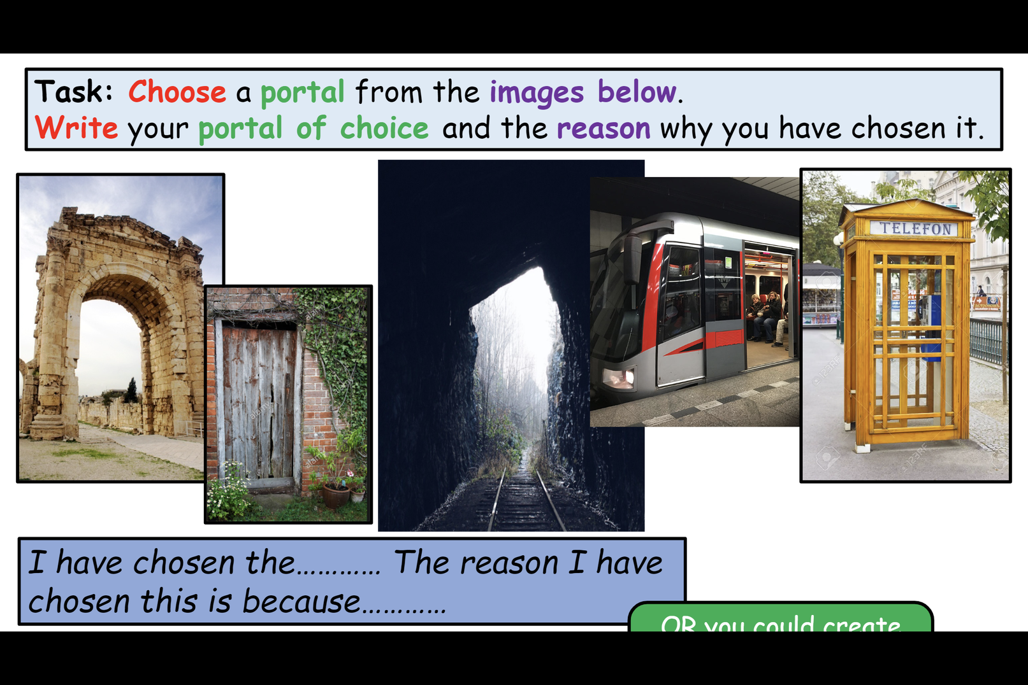
Activity
Choose a portal from the images below.
Tell me your portal of choice and the reason why you have chosen it.
OR you could create one of your own! BE CREATIVE!
I have chosen the ………… The reason I have chosen this is because…………

Slide 20
Activate
Now that you've chosen your portal, think about how you will describe it. BE CREATIVE!
My emotions/thoughts:
“I wonder how many miles I’ve fallen?”
Adjectives I will use to describe:
large
empty
My portal
What I will see:
What I will hear:

Slide 21
Activity
Use your word banks to create a five paragraph plan
Where in the real world does your description begin? What is happening? | Out in the park in the sunshine Sitting with sister who is reading Feeling bored Thinking about making a daisy chain
How do you notice the portal? What does it look like? Is there something unusual like a talking animal or a flying object?
What happens as you step through it? How does it feel?
How do you move as you travel? What do you see and hear? | Include ambitious verbs and adverbs
How do you land? How do you feel? What do you decide to do next? | Include ambitious verbs and adverbs
write 4 sentences (using the punctuation we learned) in a conversation between you and a mythical creature you meet in your portal
+ create one tongue twister

